Slide 1

Credit Card Customer Prediction
By: Daniel SHAW

Slide 2


A Bank’s Churn Problem
A Bank’s credit card Churn Rate is 16%.
Churn increases costs to replace customers.(e.g.,sign-up bonuses or rewards programs.)
Churn creates loses in annual fees, late fees, and other charges for revenue that banks rely on.

Slide 3

Questions to answer
How should a Credit Card Bank company lower churn rate by the end of the year in order to
(a) development a 80% Accurate/Precise early warning system predictive model in determining which customers will churn .
(b) Provide the bank’s management and customer service teams with insights and actionable strategies for effective intervention.

Slide 4
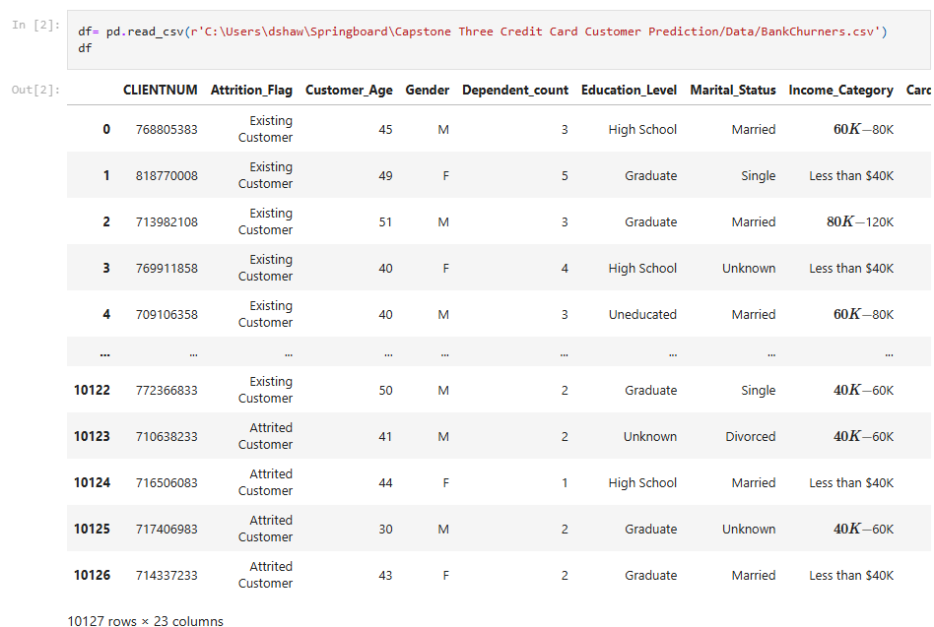
Where was the Data Gathered?
Source Data: https://www.kaggle.com/datasets/whenamancodes/credit-card-customers-prediction/data

Slide 5
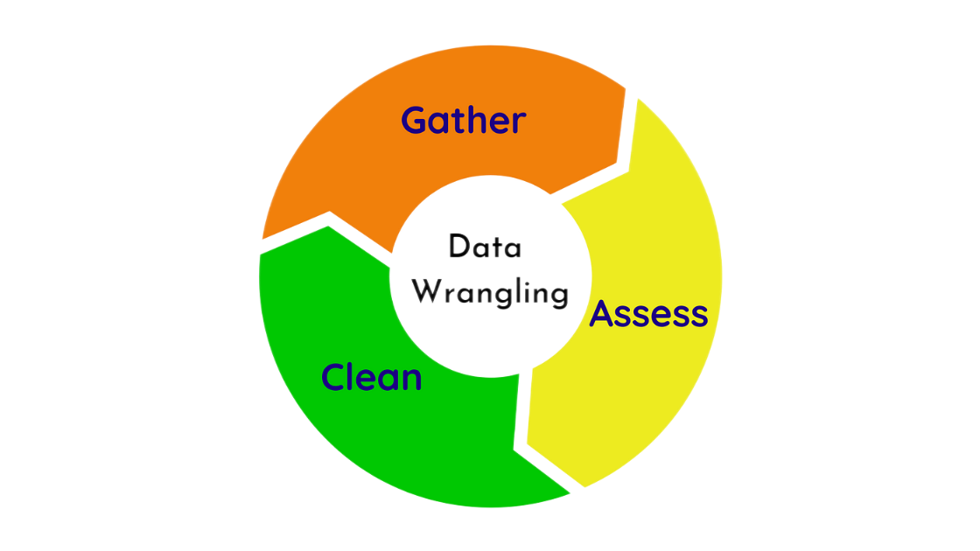
Cleaning the data (Data Wrangling)
Searched for missing values to ensure completeness, addressing any gaps in the data.
Corrected the data types of features to ensure they were appropriately assigned
Examined the dataset for unique values and duplicates, removing any unnecessary redundancies

Slide 6

Exploring the Data with Analysis (EDA)
Investigation of several key relationships between features:
Customer Churn by Age & Distribution of Customer Age
Customer Churn by Gender & Marital Status and Dependent Count
Education Level and Attrition Flag, Education Level and Income Category, & Income Category and Attrition Flag
Distribution of Card Category

Slide 7
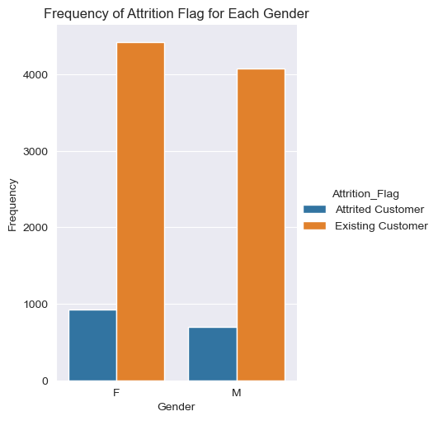
Gender and Attrition Flag (Churn)
More female customers are leaving the service as compared to males.
The total number of female customers is still higher on average overall.

Slide 8
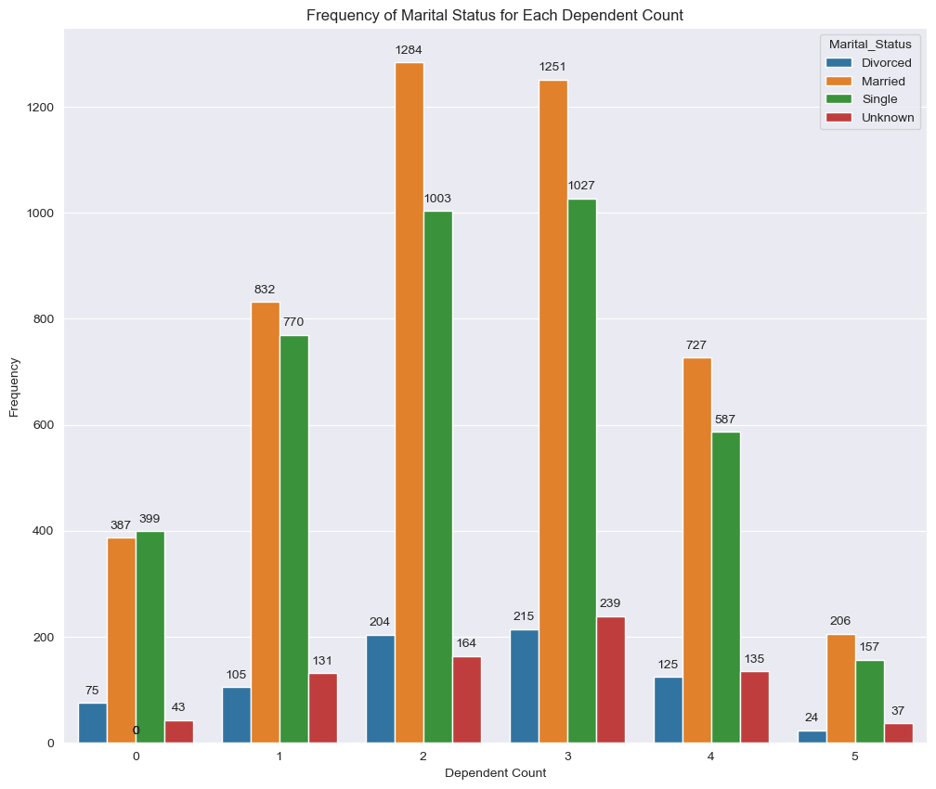

Distribution of Marital Status and Dependent count
Married individuals have the highest frequency for each dependent count.

Slide 9
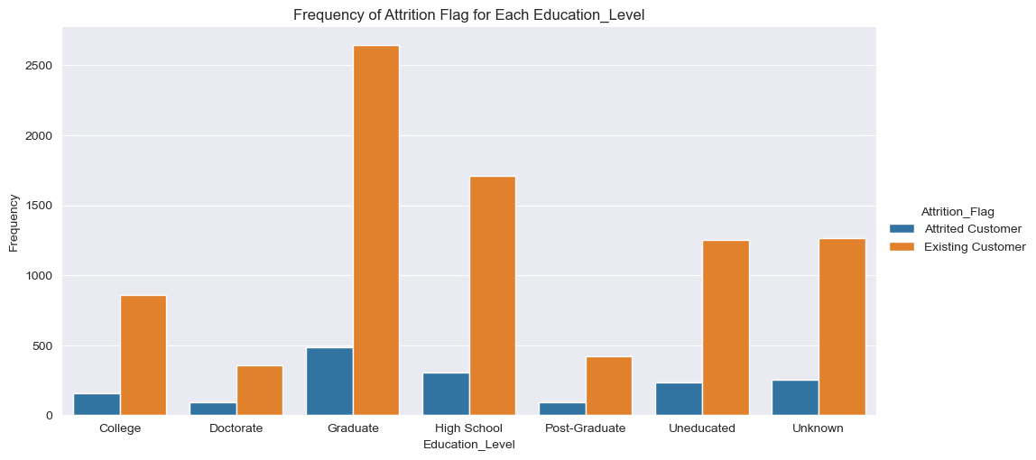
Distribution of Education Level and Attrition Flag
More Graduates customers are leaving the service more than any other education level.
Does this suggest while Graduates may have a higher tendency to churn?

Slide 10
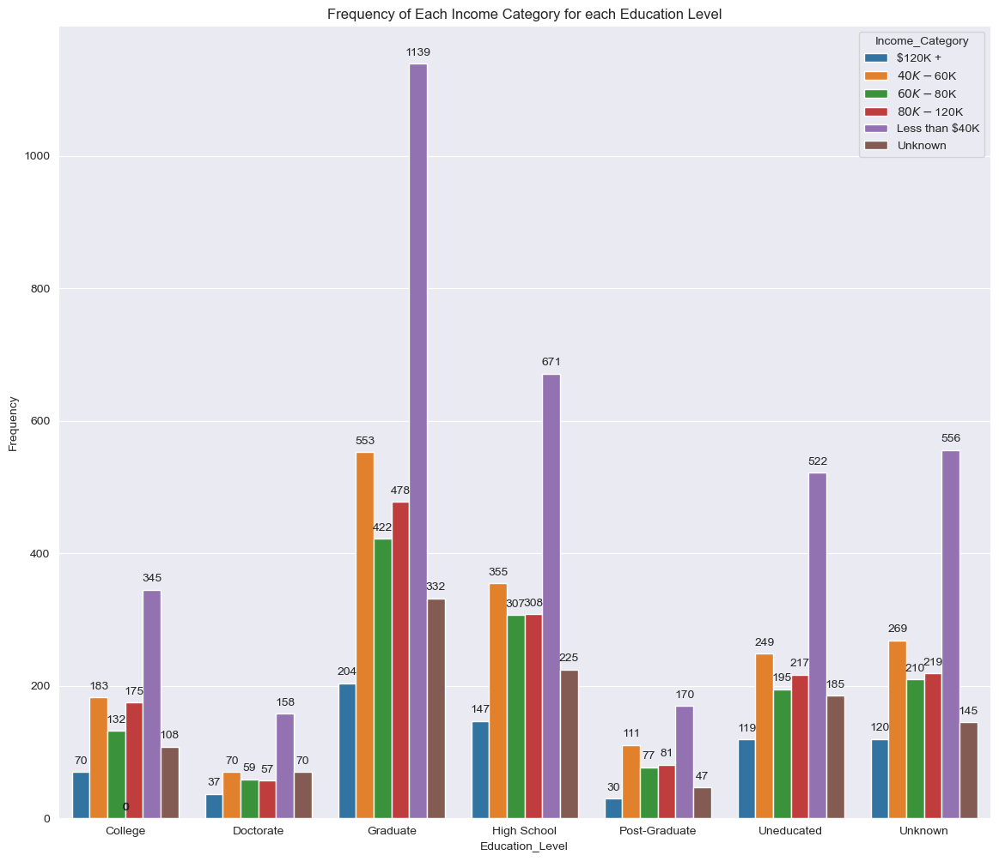
Distribution of Education Level and Income Category
Customers making less than 40k make up the majority of customers in each education level.
Income may not be strongly correlated with education in this dataset.

Slide 11
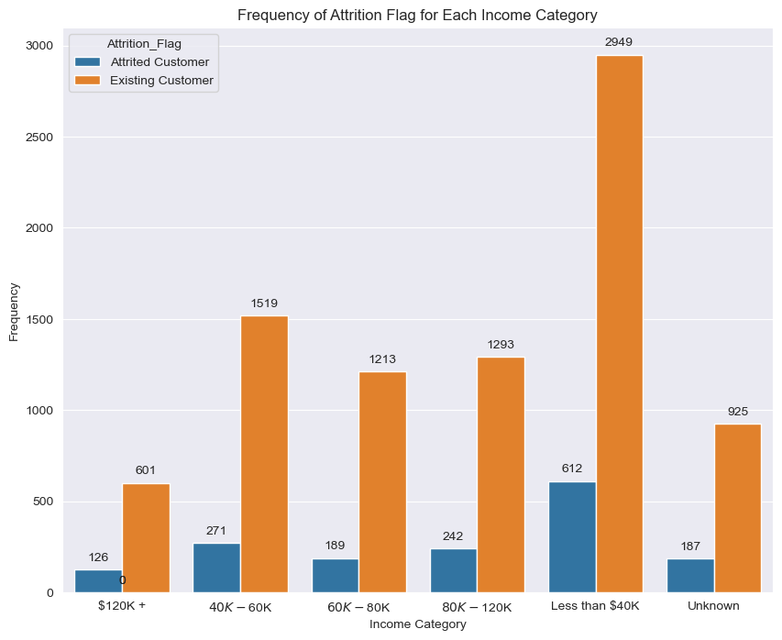
Distribution of Income Category and Attrition Flag
More customers earning less than 40k are leaving the service.
This could suggest that while customers earning less than 40k may have a higher tendency to churn , there is still a larger initial pool of customers earning less than 40k customers to begin with, so their total numbers are still higher.

Slide 12
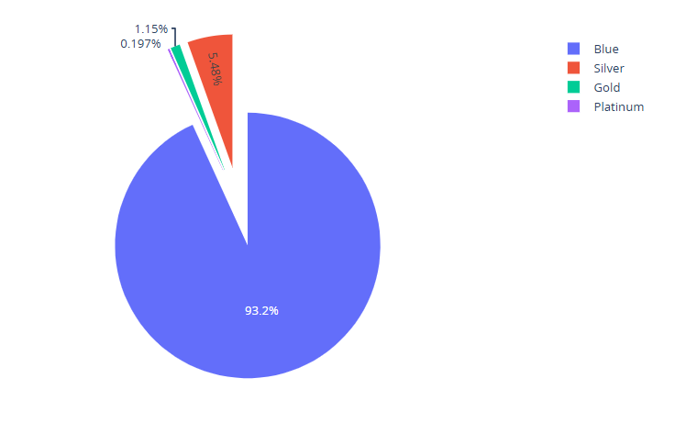
Distribution (Pie chart) of Card Category
93.2% of customers are blue card holders
The highest number of customers earning less than $40k may explain why the majority of cardholders have chosen the Blue card.

Slide 13
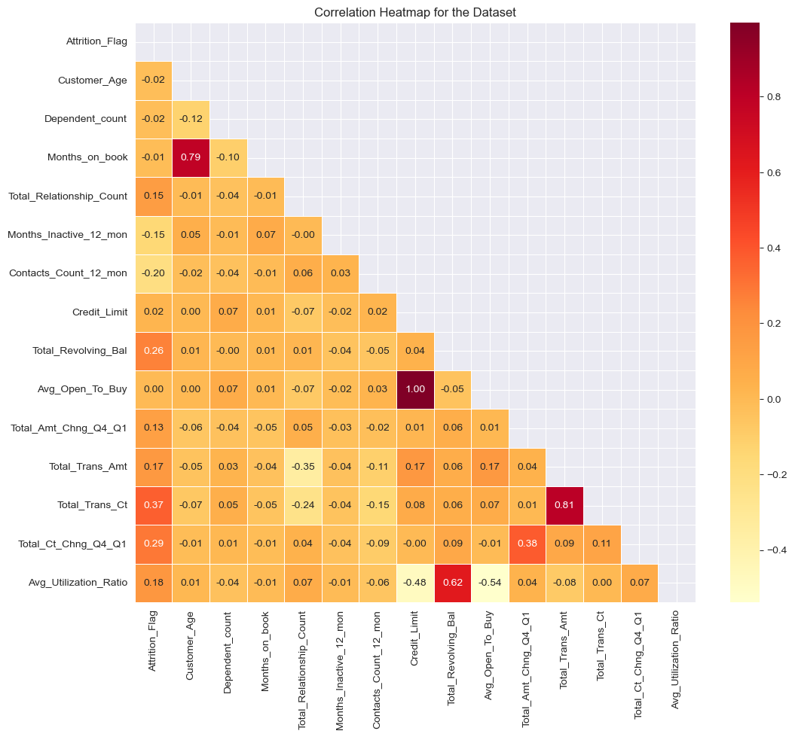
Correlation Heatmap of numerical Data
Correlation heatmap shows us where we have a corrections between numerical values.
Avg_Open_To_Buy and a very high correlation to credit limit.

Slide 14
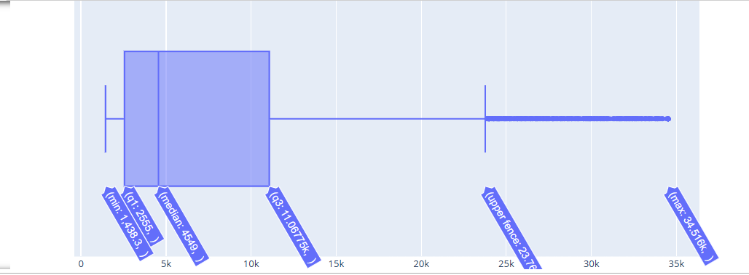
Botplot of Credit limit
Outliers can skew statistical analyses and machine learning models.
Outliers can lead to inaccurate predictions or misleading results

Slide 15

Modeling the Data
Logistic Regression
Support Vector Classifier (SVC)
Gaussian Naïve Bayes

Slide 16
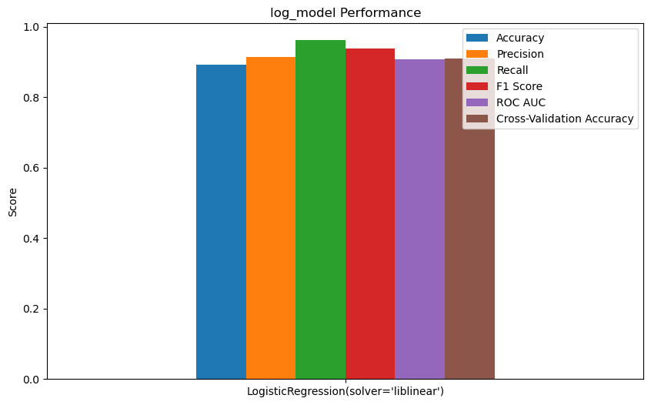
Logistic Regression Model
Accuracy – 89.3%
Precision – 91.4%
Recall - 96.2%
F1 Score - 93.7%
ROC AUC - 90.7%
Cross-Validation - 90.8%

Slide 17
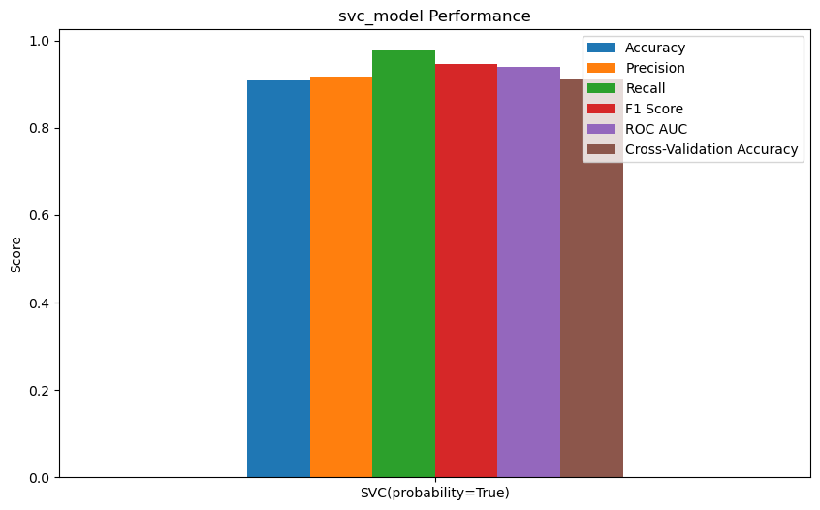
Support Vector Classifier (SVC) Model
Accuracy – 90.7%
Precision – 91.8%
Recall – 97.6%
F1 Score – 94.6%
ROC AUC – 93.9%
Cross-Validation – 91.3%

Slide 18
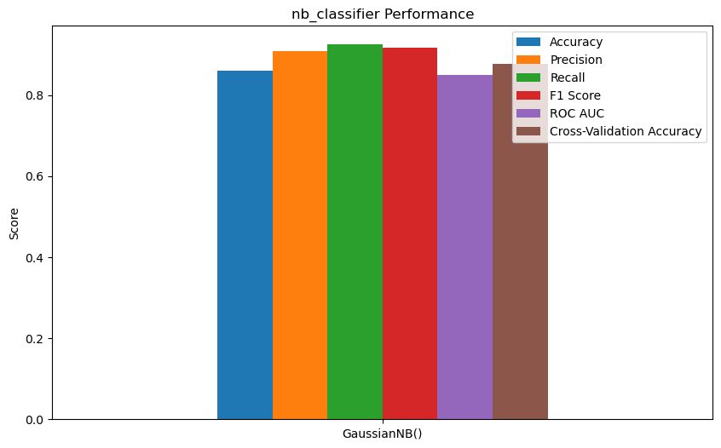
Gaussian Naïve Bayes Model
Accuracy – 85.9%
Precision – 90.9%
Recall – 92.5%
F1 Score – 91.6%
ROC AUC – 85.0%
Cross-Validation – 87.6%

Slide 19

Project Conclusion
The majority of churned customers are female graduates earning less than $40k per year.
All classification models performed better than the target margin of 80%.
The SVC with probability estimation is the top-performing model overall. It really excels in recall, with an impressive score of 97.6%

Slide 20

Model Takeaways/Recommendations
Offer more budget-friendly financial products, such as low-fee accounts or savings programs, for customers earning less than $40k.
Provide premium financial products or services tailored to graduates, such as exclusive investment or savings plans.
Introduce tiered loyalty programs that reward customers for upgrading to higher-tier credit cards.

Slide 21

Daniel Shaw

